Slide 1
Ramone Walker
Internet, Intranet, Browser and Security Research
ITCore_PS_Jarnagin__March 2017
For Professor Jarnagin
05/04/2017

Slide 2
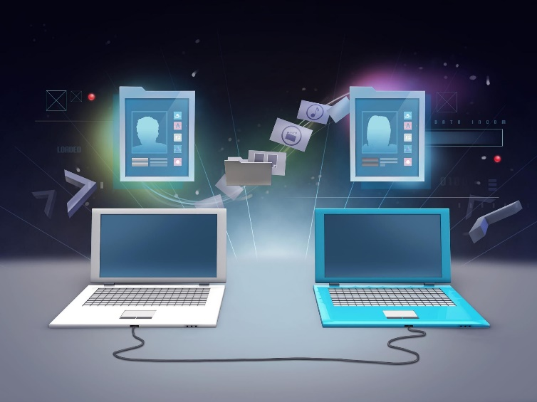
How to connect to the Internet and use appropriate Internet protocol
computer
modem
router
The internet protocol (IP) address
an IP address is like your home address.
ISP - Comcast
connect to the internet
local area network - permanent IP address

Slide 3
How do browsers work
Web Browsers receives and displays information that were located and sent by web servers. When these browsers communicate with servers, information in pages are sent built with Hypertext Markup Language (HTML). The web Browsers interpret those pages and display them on your computer.

Slide 4
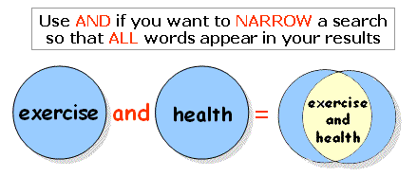
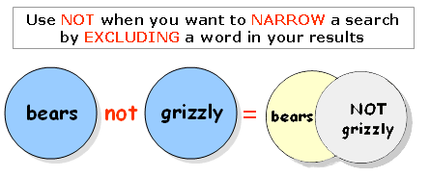
Identify Boolean search strategies
Example 1: Our topic is "how food and health are related."
Example 2: Looking for "information on salary."
Use Salary “OR” income
“Or” is used to expand your search so that any of the words show up in your results
Example 3: Your topic is about lions, but not tigers.
Use “not” when you want to narrow your search results by excluding a word
“lions not tigers” will result words contacting lions only. Not is use to eliminate terms.
Truncation
add a symbol to the end of a word
allows you to search the "root" of a word to find all its different endings.
The most common truncation symbol is the asterisk “*”.
Example: You are looking for information "the real estate industry."

Slide 5
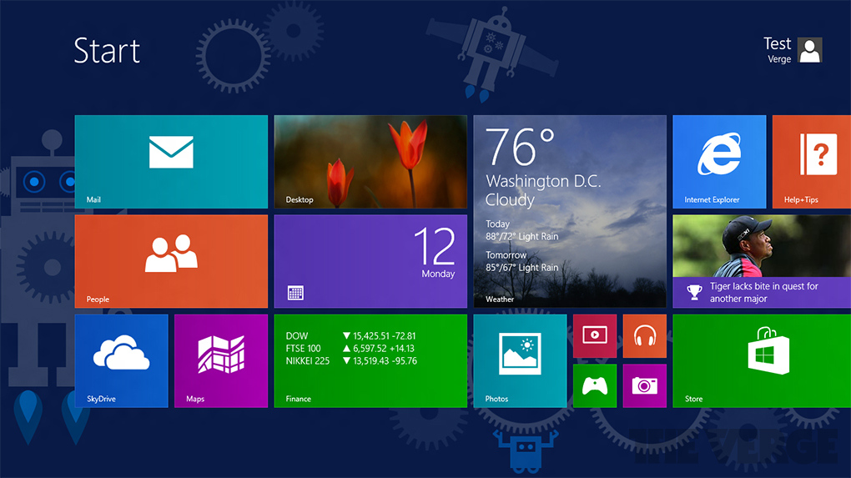
Describe basic features of GUI (graphical user interface) browsers and their basic configuration.
Microsoft Windows
Features:
Pointer
Pointing device
Icons
Desktop
Windows
Menus
GUI is a program interface that is more user friendly than command prompt user interface. In this case the user doesn't have to learn complex command languages. GUI takes advantage of the computer's graphics capabilities to make the program easier to use.

Slide 6
Describe appropriate browser security configurations
Appropriate browser security configurations are the process of securing your computer from internet attacks such as hackers and spammers.
feature settings that you can change in your computer security center to make your browser more secure:
Configure security settings by:
Set security zones
Set Internet zone security to “Medium High” or higher
Disable JavaScript
Automatically clear history:
Configure privacy settings
Privacy setting- set to high
Turn off Location
Turn on Pop-up Blocker
Configure Advanced Security settings

Slide 7
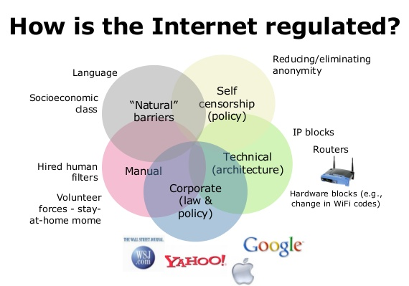
Describe the Internet, Intranet, and regulatory control
Intranet is a private network that is not available to the world outside of the Intranet
Internet is the world-wide network of computers accessible to the world's public
According to InternetSociety.org Internet regulation is basically restricting or controlling access to certain aspects or information. Internet regulation consists of: Censorship of data, and controlling aspects of the Internet such as domain registration, IP address control and more.

Slide 8
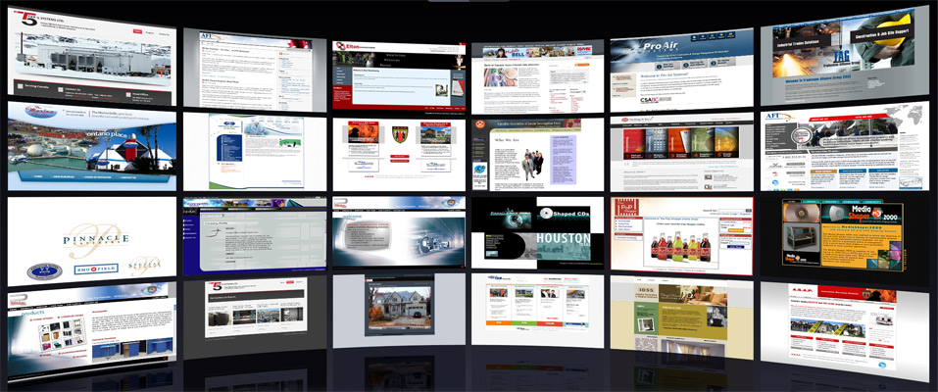
List the Universal Resource Locators (URLs) for the sites researched
www.fcc.gov
www.internetsociety.org
www.hcidata.info
www.webopedia.com
www.li.suu.edu
www.google.com
www.computerhope.com
web.stanford.edu
en.wikipedia.org
www.pluralsight.com

Slide 9
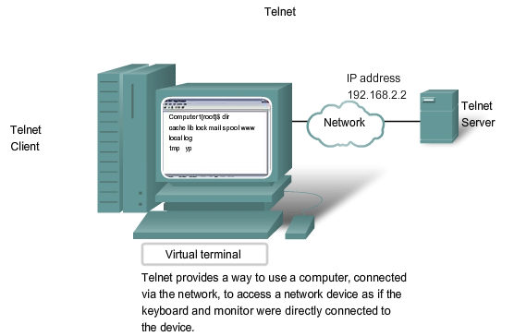
Describe telnet, plug-ins, and data compression
Telnet
Telnet is a network protocol that allows a user on one computer to log onto another computer that is part of the same network.
Plug-ins
In the world of computers, a plugin is a software component that adds a specific feature to an existing computer program or browsers. When a program supports plug-ins, it enables customization. One of the most popular browser that allows plugins is google chrome.
Data Compressing
Data compressing involves the reducing of information or data into lower bits than the original representation.

Slide 10
Describe how to download files
There are many ways to download file and downloading a file is as simple as a click.
1. First you visit the location or website where you want to download the files.
2. Once you get there you right click on the file you want to download then click save as or print.
When you click print it will give you additional options like print as a Microsoft PDF file.
Once you click save as it will open up a new window then you choose the location where you want to download the file on your computer.
3. click save and then you are done.

Slide 11
Describe how to transfer files
Click on the file you want to transfer then right click and save as,
choose the location where you want to transfer it name it and click save.
right click on the file you want to transfer then click copy and paste it in the location you want to transfer it or cut it and paste it in the location where you want to transfer it.

Slide 12
How to effectively use slides and what "not to do"
Create an outline
Use Contrasting Colors
Use a big enough font
Stop the moving text
Turn the pointer off
Use visuals instead of text slides
Number your slide so they are easy to be found and it helps the audience to keep track
What not to do when create slides for a presentation:
Reading Your Slides to The Audience
Don't add too much picture on a slide to the point where it has an infinite clutter
Avoid slide Transitions
Don't use low quality images, Graphics, Images, Graphs, WordArt, SmartArt.
Don't use too much different colors...don't make the audience wish they were color blind

Slide 13
The End

